Slide 1
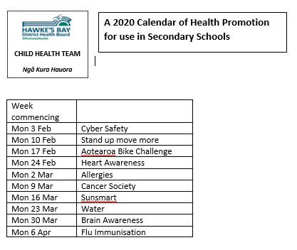

Slide 2
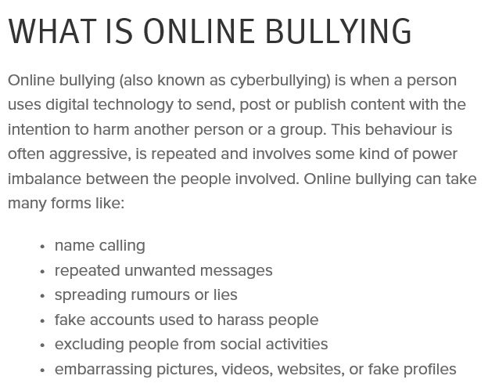
www.healthed.govt.nz
https://www.netsafe.org.nz/bullying-abuse-support/

Slide 3
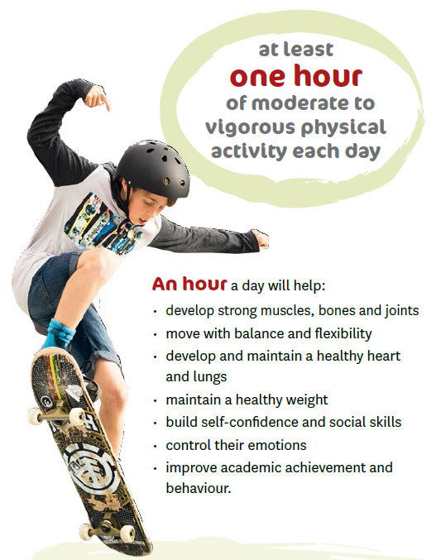
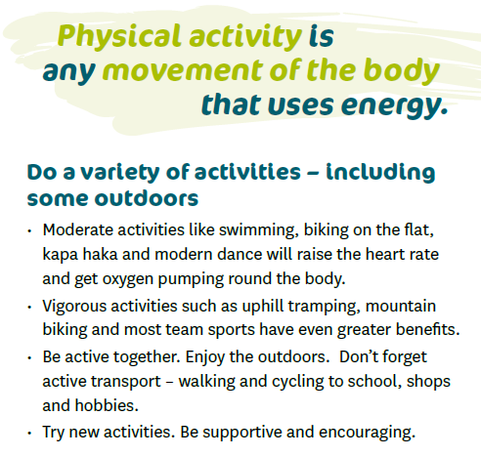
www.healthed.govt.nz
https://www.health.govt.nz/your-health/healthy-living/food-activity-and-sleep/physical-activity/sit-less-move-more

Slide 4
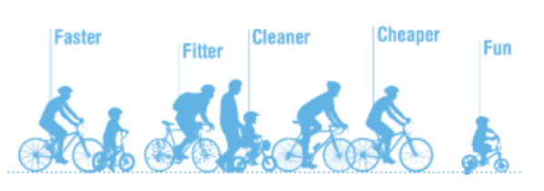
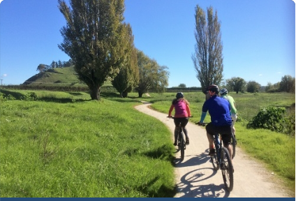
February is BikeWise month
Bike Wise is New Zealand's national programme of activities promoting cycling as a fun, healthy and safe way to travel.
Why not join us and get in the saddle?.
For events in your area, check http://www.bikewisechallenge.co.nz/
Cycling to School?
Plan: Plan your route avoiding busy roads and intersections.
Carry: Carry as little as possible on your back. You’re safer with your school bag strapped to the back carrier.
Rules: The roads can be safe if everyone follows the rules. That includes cyclists!
www.healthed.govt.nz

Slide 5
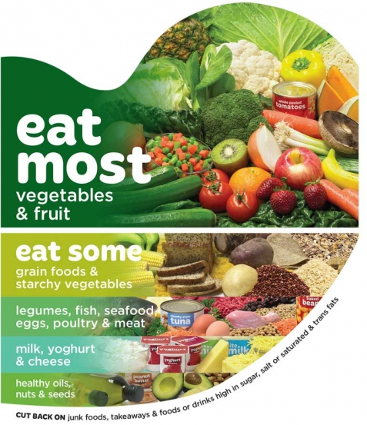
There are many ways you can eat to support your heart health and all of them are simple variations on a common dietary theme. The key is to base your diet around foods that are as close to how they are found in nature as possible. This means eating plenty of vegetables and fruit, some whole grains in place of refined grains, legumes, nuts, seeds, and other sources of healthy fats such as oily fish. You may also choose to include non-processed lean meats, poultry and/or dairy.
www.healthed.govt.nz
https://www.heartfoundation.org.nz/wellbeing/healthy-eating/eating-for-a-healthy-heart

Slide 6
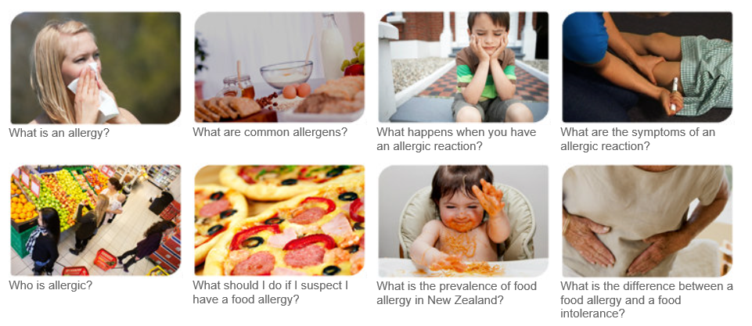
www.healthed.govt.nz
http://www.allergy.org.nz/

Slide 7
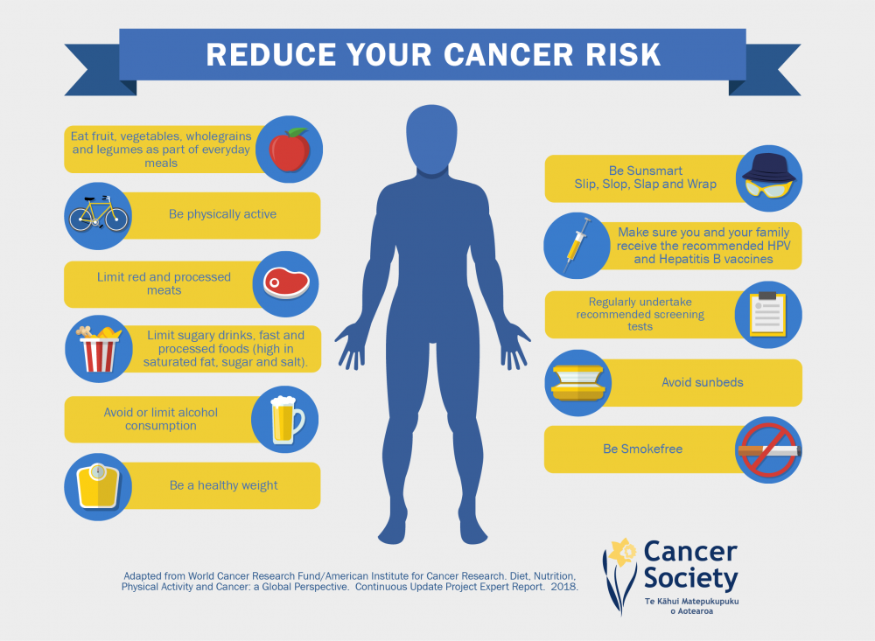
www.healthed.govt.nz
https://cancernz.org.nz/

Slide 8
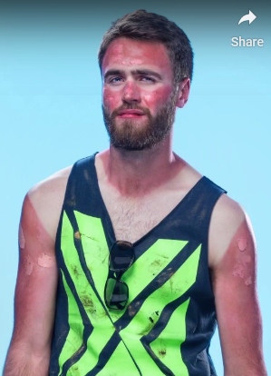
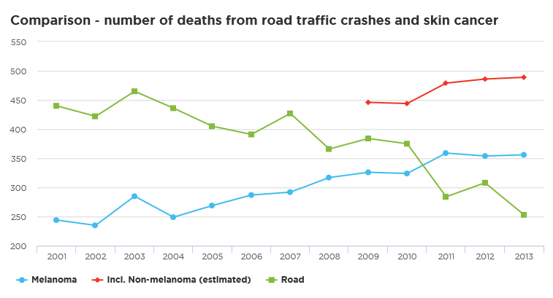
Be safe - be SunSmart
New Zealand sunlight has high levels of ultraviolet (UV) radiation. UV radiation can cause skin and eye damage. You can protect yourself and your children by being SunSmart. Learn how to keep safe while still living life in the sun.
www.healthed.govt.nz
https://www.sunsmart.org.nz/

Slide 9
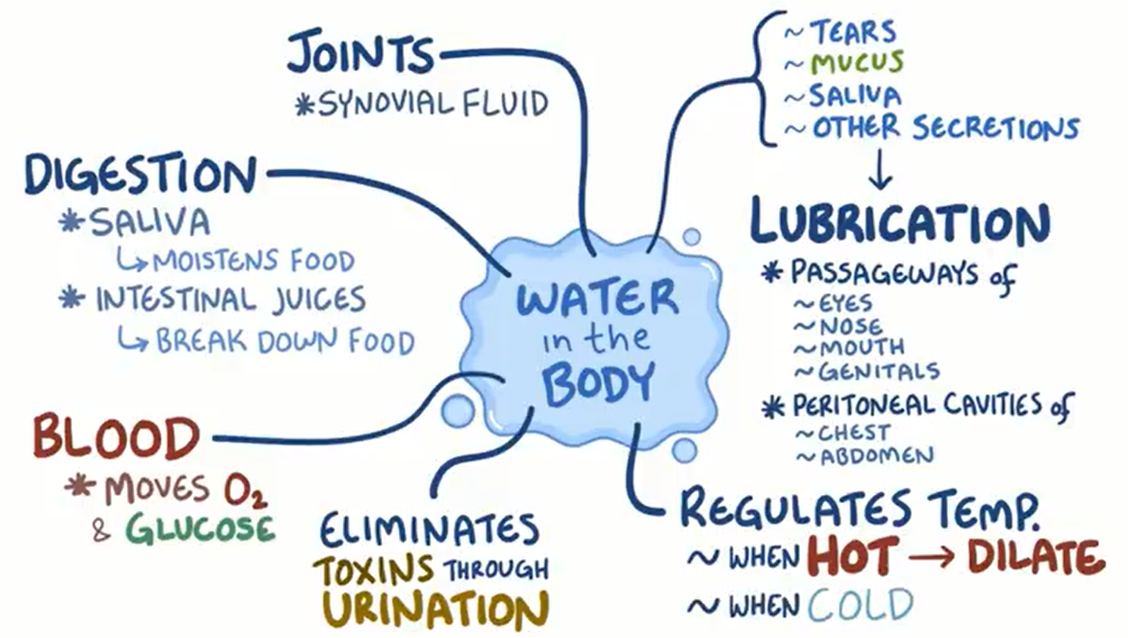
www.healthed.govt.nz
https://nutritionfoundation.org.nz/nutrition-facts/nutrition-a-z/Fluid

Slide 10
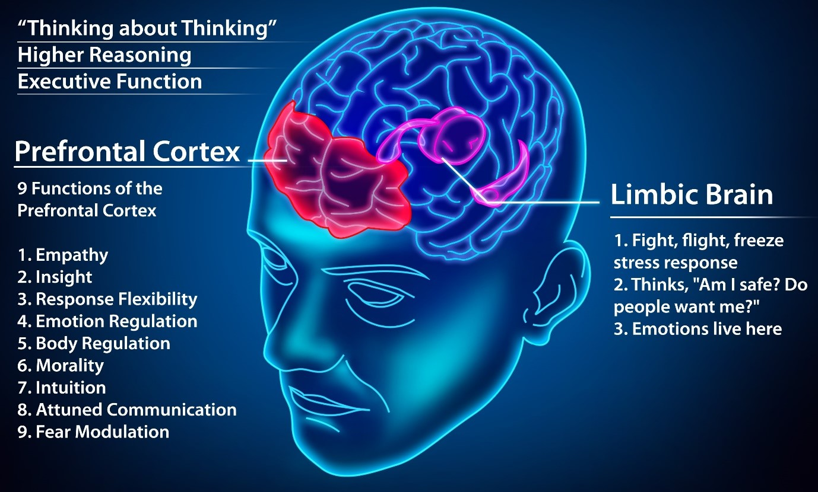
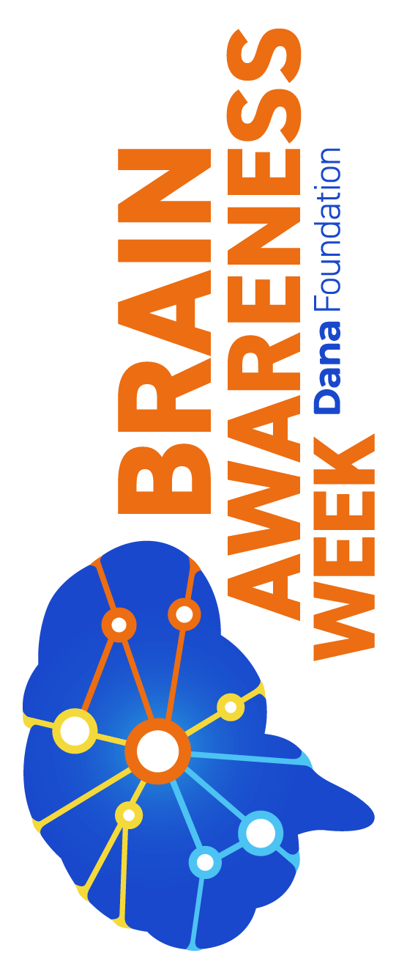
www.healthed.govt.nz
https://www.loveyourbrain.com/about

Slide 11
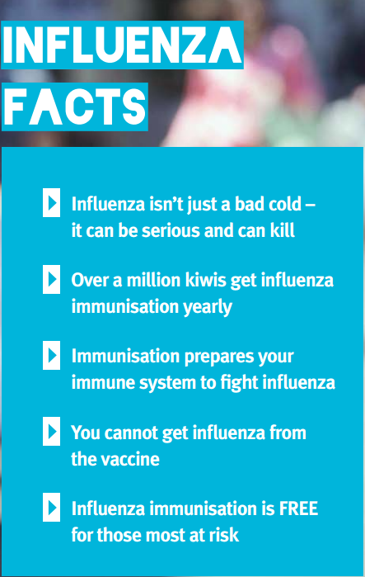
www.healthed.govt.nz
https://www.fightflu.co.nz/influenza-facts

